Slide 1



IDSE PROJECT PRESENTATION
Presented by BHARGAVA TEJA

Slide 2
Fitness Progress Prediction and Personalized Recommendations
We aim to predict weight of individuals after 2 months based on current fitness metrics to provide tailored fitness and dietary recommendations.

Slide 3
TYPES OF DATA REQUIRED (INPUT AND OUTPUT VARIABLES)
Input Variables (Features):
Age - Height (m) - Weight (kg) - Session Duration (hours) - Calories Burned
Output Variable (Target):-
Weight 2 Months after (kg) - Predicted BMI after 2 months
Source of Data Collection:-
Collected from Institute Gym Members.

Slide 4
EXPLORATORY DATA ANALYSIS (EDA)
Data Preparation:- Handle missing values (mean for continuous variables, mode for categorical variables). - Calculate additional metrics like BMI.
Data Visualization:- Histograms for feature distributions. - Heatmap for correlation analysis.

Slide 5
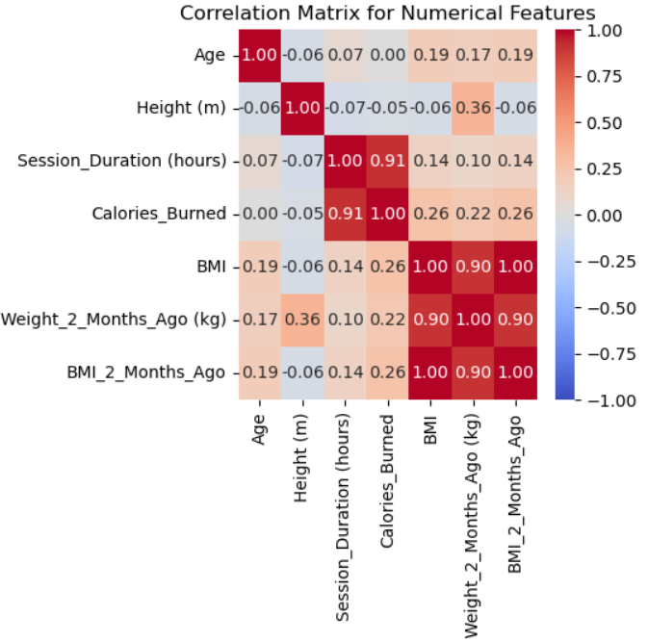
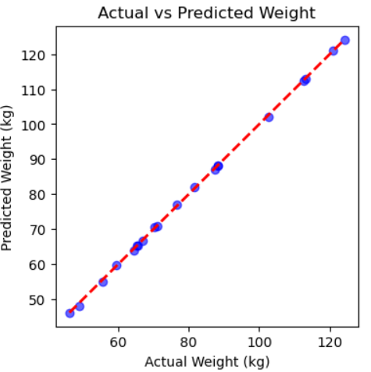

Slide 6
SELECTION AND APPLICATION OF MACHINE LEARNING
Model Chosen
Training and Testing Process
The data split (80% training, 20% testing).
Performance metrics: MSE, R².
Multiple Linear Regression.

Slide 7

SOLUTION FOR THE PROBLEM
Solution Approach:
Data Collection and Cleaning: Loaded a fitness dataset and handled missing values to ensure data integrity.
Feature Engineering: Calculated BMI to add valuable insights on body composition.
Linear Regression Model:
Chose linear regression to model the relationship between input features (age, height, weight, session duration, and calories burned) and target (weight 2 months after).
Linear regression provides a simple, interpretable approach that captures direct relationships in the data.
Built using a pipeline to ensure standardized data preprocessing (scaling features).
Custom Prediction Function: Accepts user inputs for personalized predictions and recommendations based on the regression output.
Outcome: An interpretable model that predicts future weight based on current metrics, allowing individuals to track and optimize their fitness routines.

